Slide 1
SMART TRAFFIC MANAGEMENT
SeattleData AI & Security Speed Hackathon
NAME

Slide 2
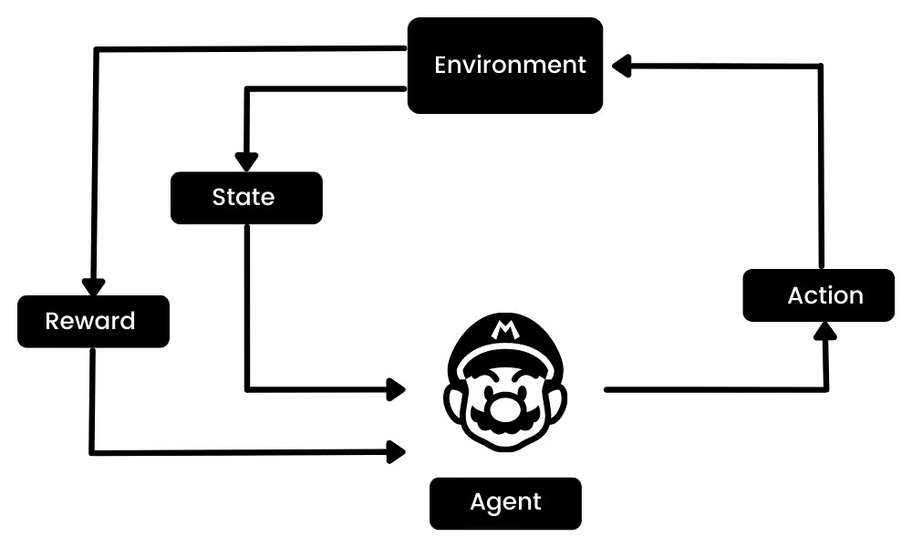
Problem Statement & Solution Approach
Problem Statement:
Urban traffic congestion leads to delays, increased fuel consumption, and emergency vehicle obstructions.
Traditional traffic light systems are often static and fail to adapt to real-time traffic flow.
Solution Approach:
We propose a Reinforcement Learning (Q-Learning) based agent to dynamically control traffic signals.
The system learns to minimize queue lengths and prioritize emergency vehicles by switching lights intelligently.

Slide 3
Q-Learning
We will using the Q-table for this project. Q-table is a lookup table used in Q-learning (a reinforcement learning method). It stores the expected future reward for each combination of:
A state s (what the traffic looks like now), and
An action a (whether to keep the same light or switch it).
Phase 0: Green for North-South, Red for East-West.
Phase 1: Green for East-West, Red for North-South.
Q[state][action] = expected future reward
State: (queue_length_ns, queue_length_ew, current_phase)
(3, 7, 1) → NS queue ~3, EW queue ~7, current phase is EW green
We only have 2 possible actions: 0: Keep current phase 1: Switch phase
reward = (old_queue_total - new_queue_total) - imbalance_penalty -> go down: positive reward go up: negative reward
Q[s][a] ← Q[s][a] + α * (reward + γ * max(Q[s’]) - Q[s][a])
α = learning rate (how fast to learn)
γ = discount factor (how much future reward matters)
80
70
60
50
40
30
20
10
BAR GRAPH INFO 1
BAR GRAPH INFO 1
BAR GRAPH INFO 1
BAR GRAPH INFO 1

Slide 4
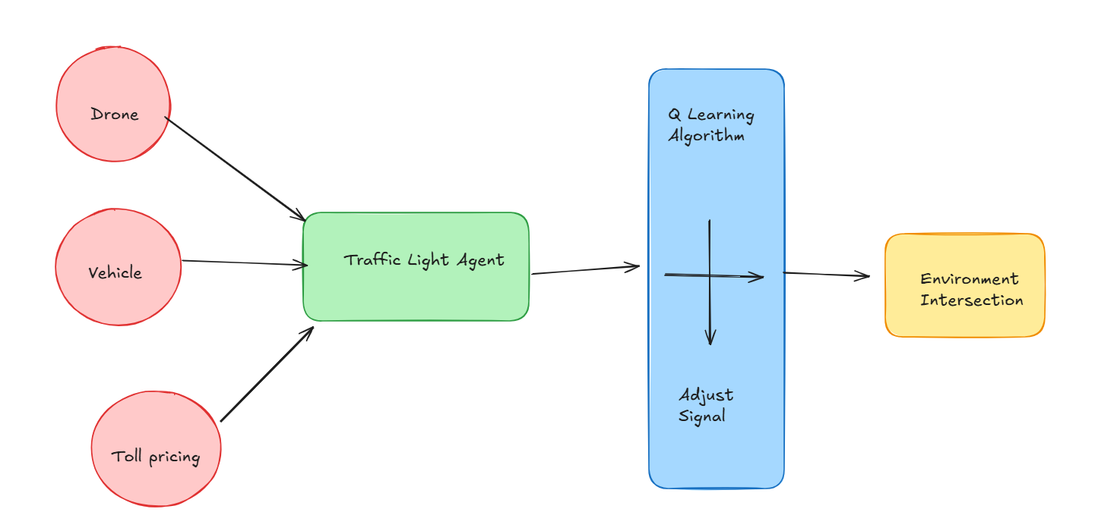
Technical Architecture
TrafficLightAgent (Q-learning): Learns optimal signal switching strategy via state-action-reward updates.
VehicleAgent (V2I Communication): Models cars, including emergency vehicles.
DroneAgent: Randomly detects and reports incidents (accidents, blockages).
TollAgent: Adjusts toll dynamically based on congestion.

Slide 5
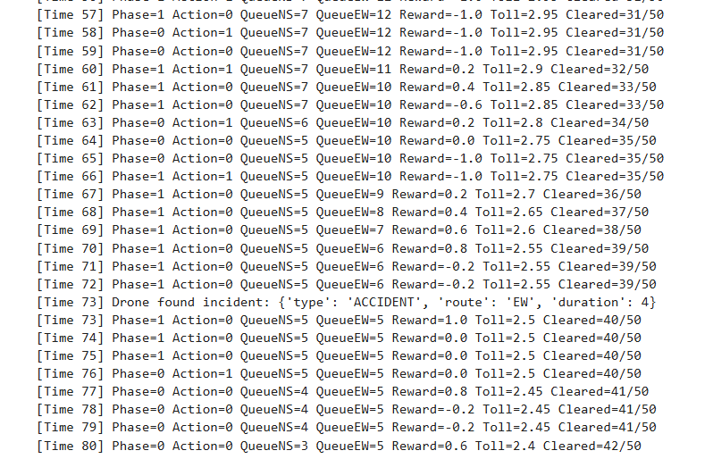
Demo

Slide 6
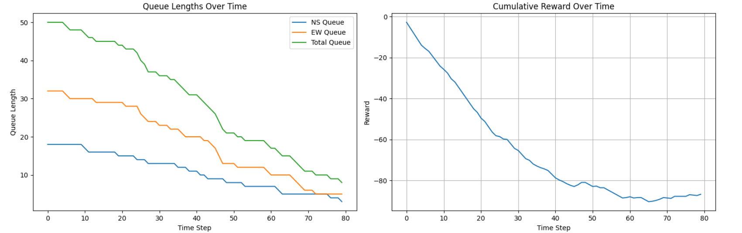
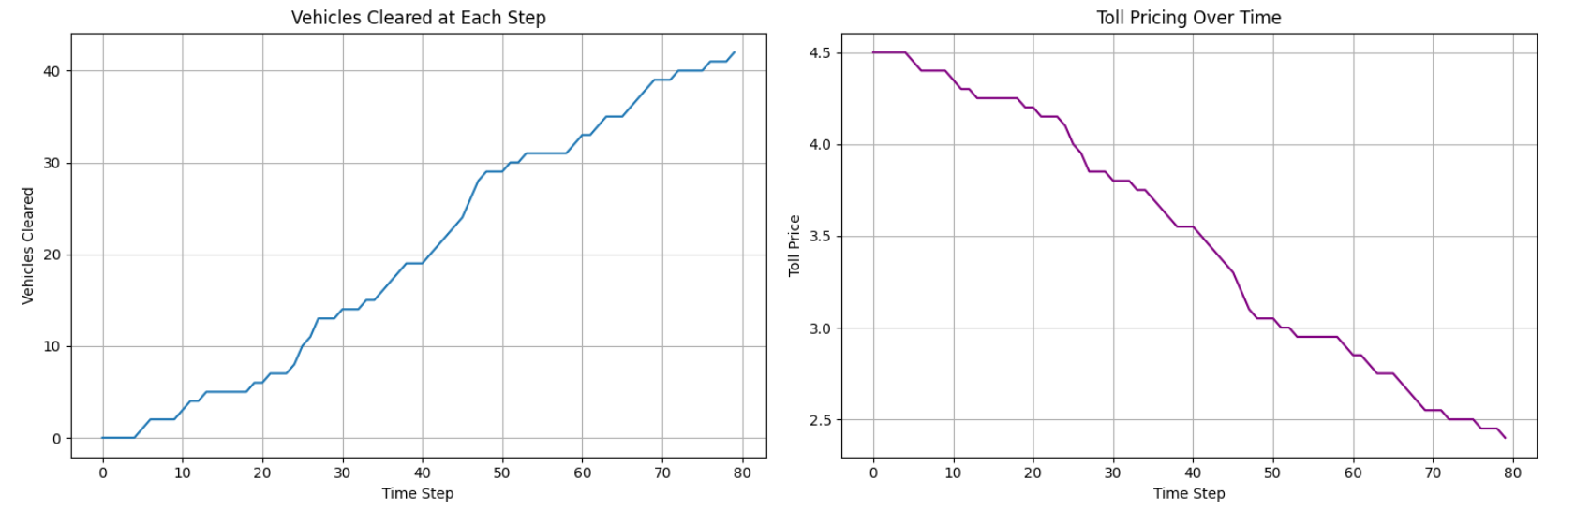
Visualization

Slide 7
Challenges & Learnings
Challenges:
Designing a reward function that balances fairness and congestion.
Handling stochastic events like emergency vehicles and random accidents.
Learnings:
Simple tabular Q-learning can be effective for small state spaces.
Visualizations help debug and validate agent decisions.
Future Enhancements
Integrate Deep Q-Network (DQN) for high-dimensional states (e.g., full traffic map).
Add support for multiple intersections and cooperative agents.
Use real-world traffic datasets for validation.
Enhance re-routing strategies and vehicle behavior models.
UI dashboard for monitoring and tuning agent behavior.

Slide 8
Questions?

Slide 9
THANK YOU
COMPANY NAME

